Slide 1
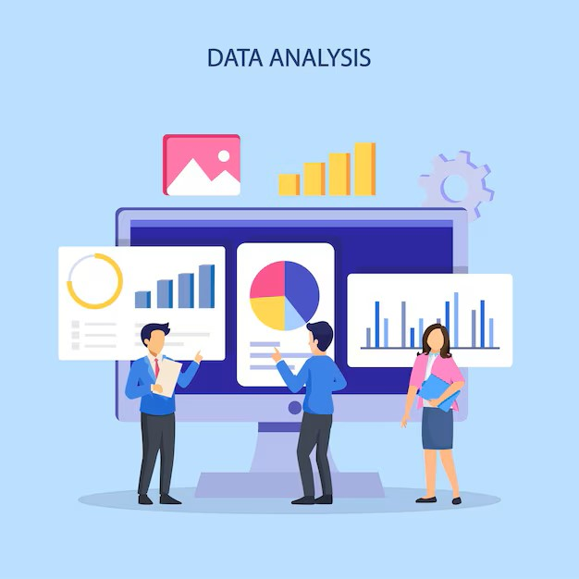
DATAMITES - INTERNSHIP
PROJECT ID: PRDA-05 CUSTOMER DATA ANALYSIS
PROJECT TEAM ID: PTID-CDA-dec-25-1033
Project By: priyanka c.m

Slide 2
PROJECT OVERVIEW
This Project is about ‘Analysing Customer Data’ in which the dataset contains shopping information from 10 different shopping malls between 2021 and 2023. We have gathered data from various age groups and genders to provide a comprehensive view of shopping habits in Istanbul. The dataset includes essential information such as invoice numbers, customer IDs, age, gender, payment methods, product categories, quantity, price, order dates, and shopping mall locations.

Slide 3
ANALYZING THE PROJECT
Analysing the business need of the given project is the most crucial and the initial step.
Here in this ‘Customer Data Analysis’ the idea of the project is to solve the business needs and provide some valuable insight for the improvement of the business.
Here in this project we are about to solve some tasks which we are supposed to do.
As mentioned in previous slide We are provided with dataset of 10 different shopping malls from Istanbul from the year 2021 to 2023.

Slide 4
DATASET AND TASKS
The shopping mall customer dataset consists of details like invoice_no, customer, gender, age, category, quantity, price, payment_method, invoice date, shopping mall
We need to find the insights with the given tasks like
How is the shopping distribution according to gender?
Which gender did we sell more products to?
Which gender generated more revenue?

Slide 5
Distribution of purchase categories relative to other columns?
How is the shopping distribution according to age?
Which age category did we sell more products to?
Which age category generated more revenue?
Distribution of purchase categories relative to other columns?
Does the payment method have a relation with other columns?
How is the distribution of the payment method?

Slide 6
DATA PREPROCESSING IN SQL SERVER
First step is to set up a connection with the Datamites Server with the given credentials and Loaded the Dataset in SQL Server
Performed data profiling to assess the dataset’s characteristics (e.g., row count, unique values, statistics, missing data, duplicates)
Checked unique values in invoice_no and customer_id
Checked the categorical columns
checked the summary statistics
Checked for the missing values in the columns
Checked for the Duplicates

Slide 7
DATA EXPLORATION IN POWER BI
After doing all the Preprocessing in SQL Server, the cleaned dataset in the form of CSV file is then exported into local for exploring the patterns and relationship .
After importing we need to check once again whether the dataset imported properly without any missing in rows or columns
Now the data is ready to be explored in deeper

Slide 8
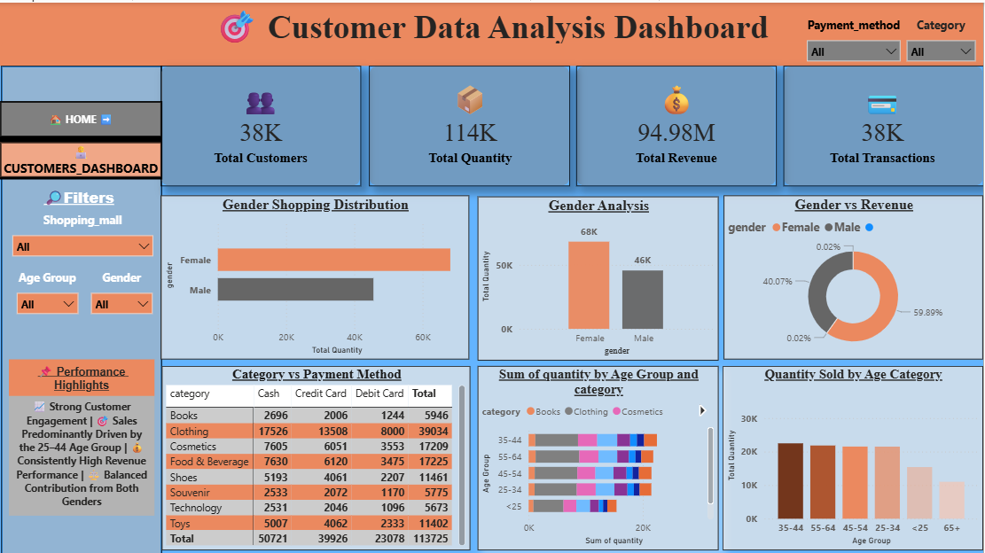
DATA VISUALIZATION in ‘Power bi’

Slide 9
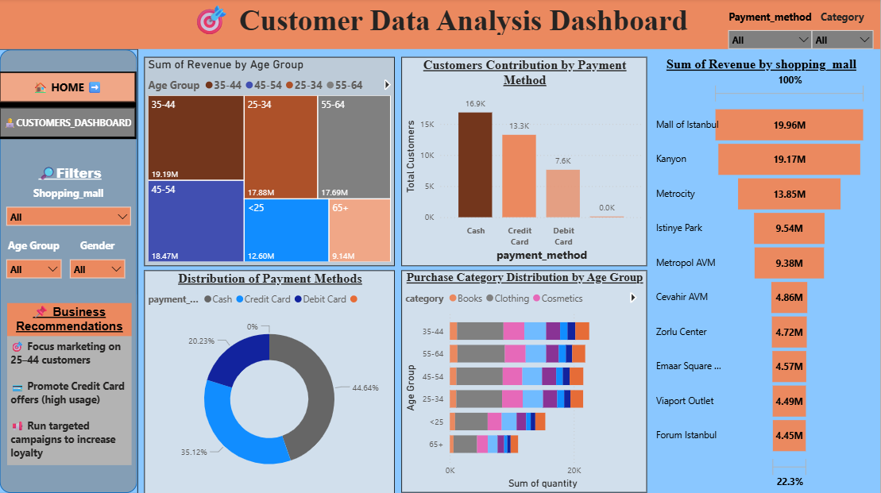

Slide 10
CONCLUSION
Females were more revenue generators than Males
Clothing was purchased more in both the genders
Payment method was done highly with cash
Among all the ten shopping malls ‘mall of istanbul’ was more revenue generated
The Final take on the conclusion with these Business Insights is
“Need to increase more payment method with Debit Cards by proceeding with more Advertisements and Awareness programs with Customers”
“Need to improve the habit of purchasing books among customers by introducing more stalls with more Genre of books among kids and youths”
“Males were least revenue generators than females, so to increase more number of male customers need to provide more offers on tech category to males”
Investing more to attract males via Campaigns regarding Offers for males will lead to more Revenue from them

